Slide 1
ENG EK 210 A2
Final Project of Pulse Oximeter
By Dabin Jang

Slide 2
Approach to measure the Oxygen Saturation
The light absorption properties of hemoglobin are influenced by the presence of O2.
Oxygenated Blood -> Strongly absorbs 850 nm.
Deoxygenated Blood -> Strongly absorbs 650 nm.
Use IR-LED(850 nm) and Red-LED (650 nm) to measure the pulse rate.
Based on the pulse rate, calculate for the value of R.
Substitute the value into the given equation for SaO2.
Calculate the unique value Alpha.

Slide 3
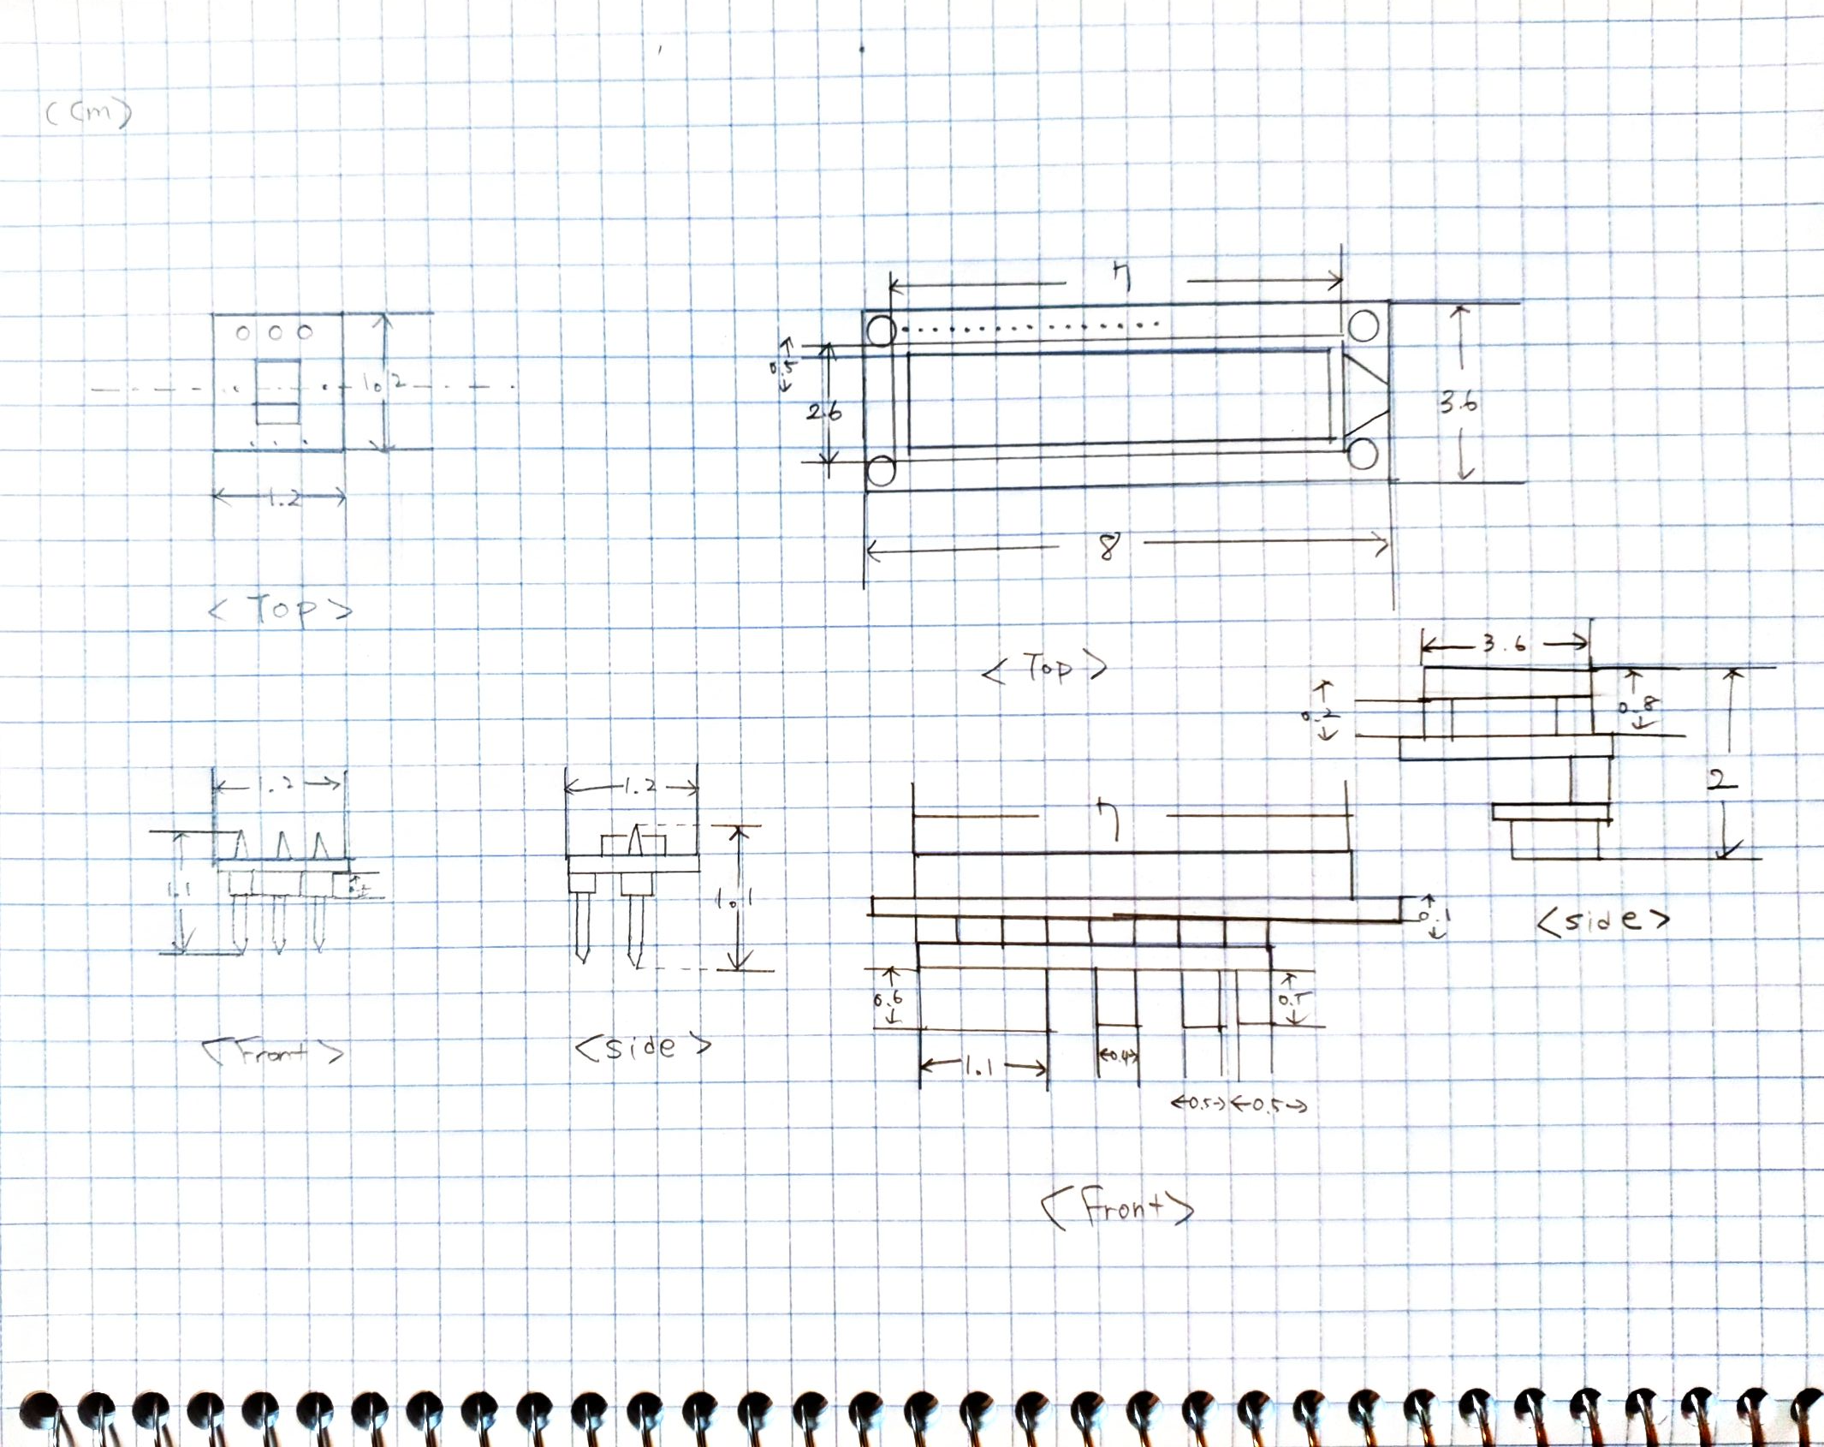
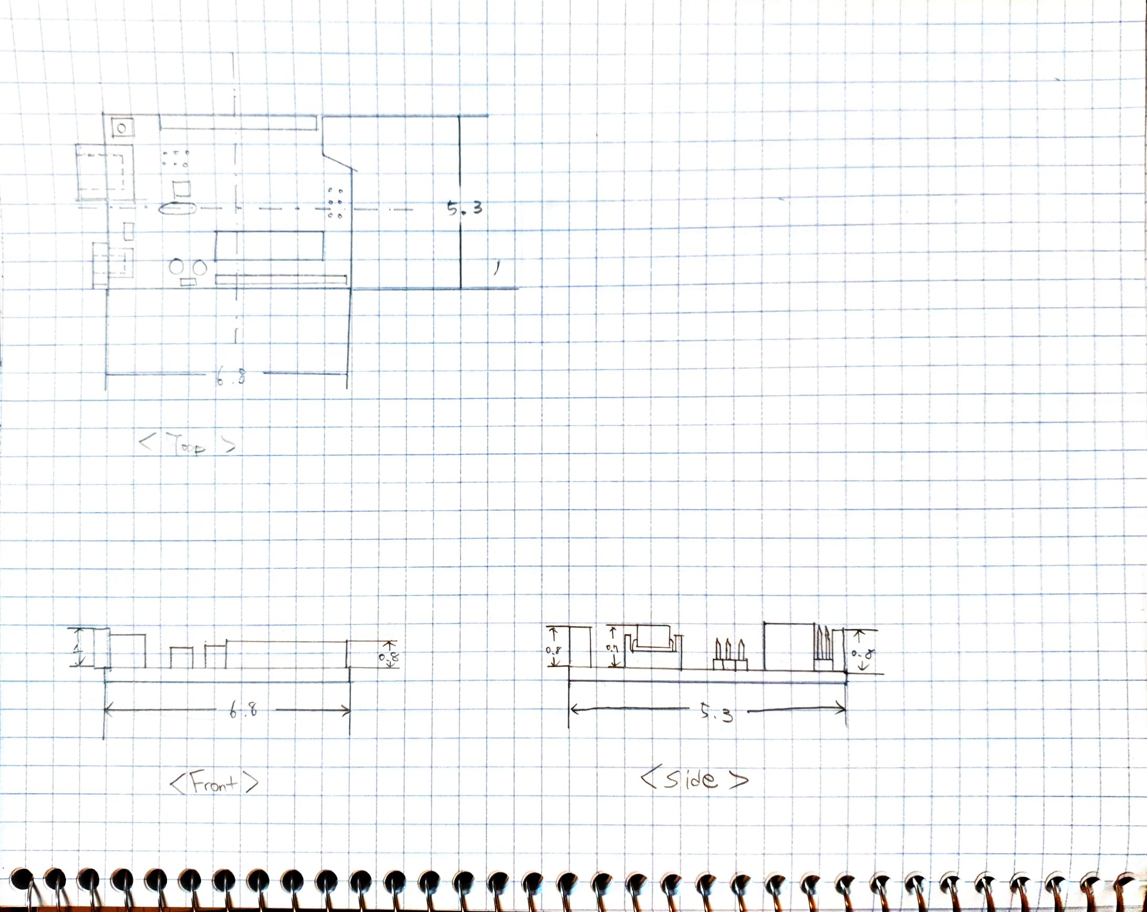
Schematics and Drawings

Slide 4
A Performance Assessment
Due to the limitation of resources and time,
The function of the device can be improved.
The manual calculation parts can be done automatically by using MAXREF chip and the right Arduino code.
The saturation rate can be directly shown on LCD screen for faster and better understanding of the result.
Both Red LED and IR LED can work together at the same time without changing the code manually.
The design of the device has room to be improved.
The material of the case(cover) can be changed to plastic for durability.
The OPT 101 chip and two LEDs can be packaged separately for better external features.

Slide 5

Short Videos of the Product

